Slide 1
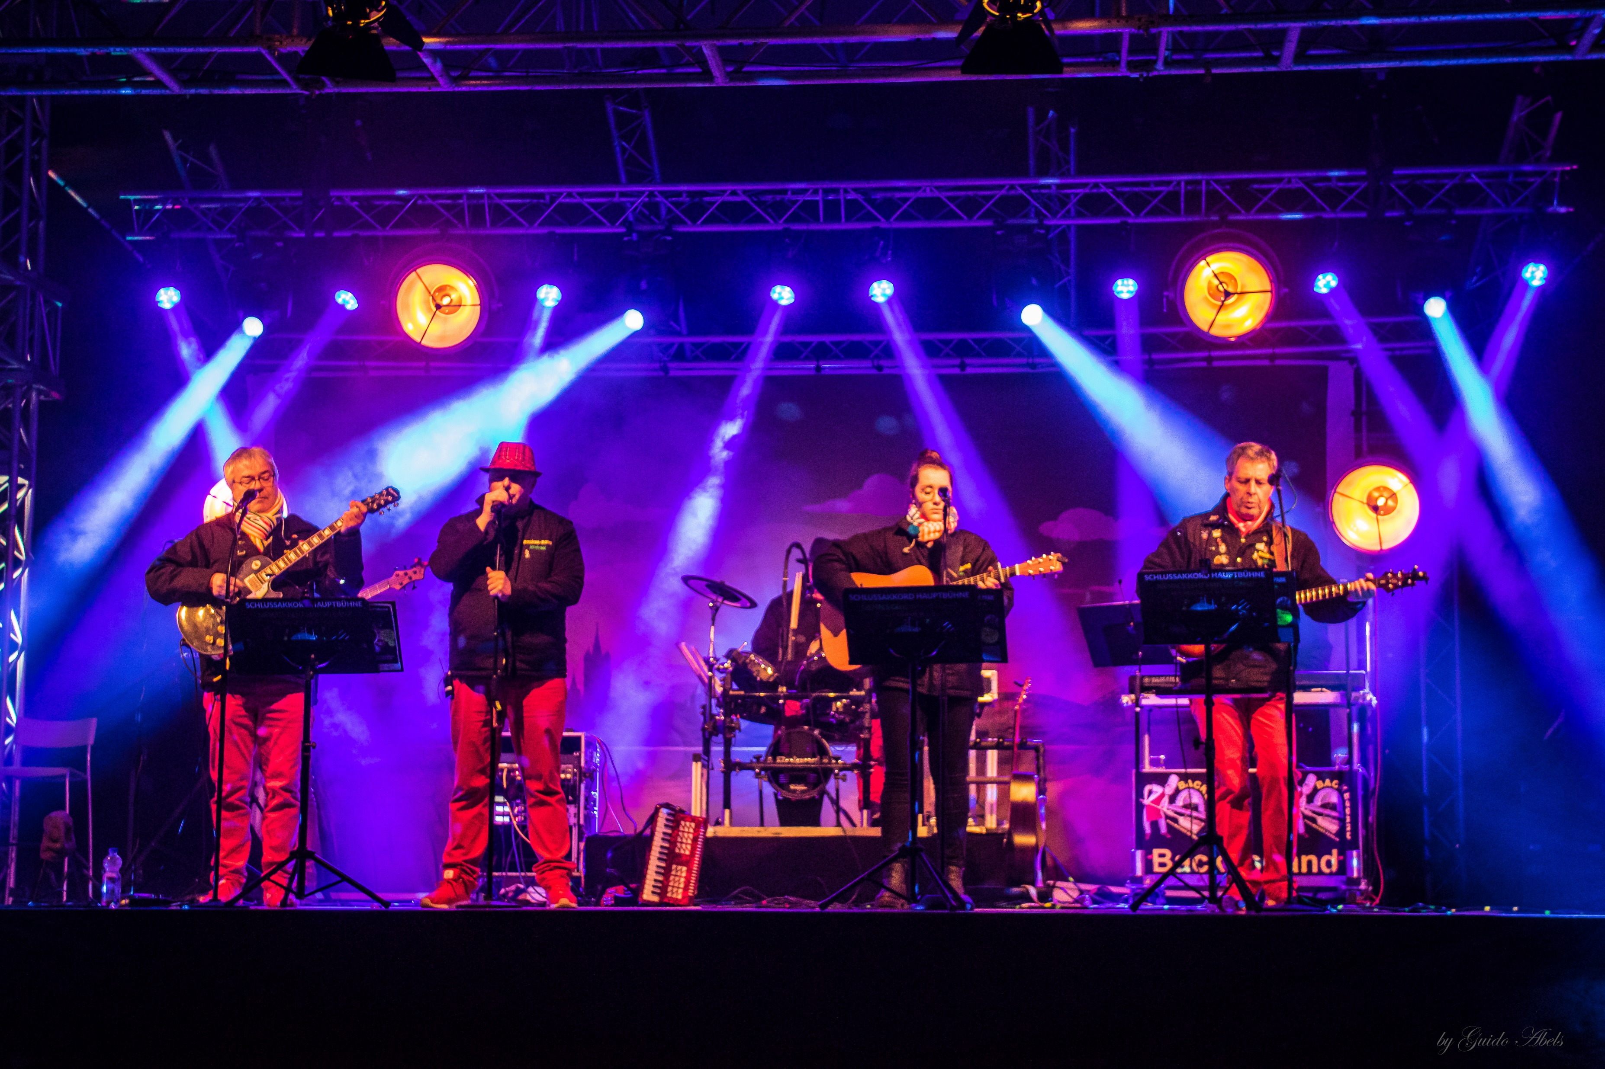
Kölsch!
ive!
Backesband
By Guido u. Lukas Abels
Photogrph

